Slide 1

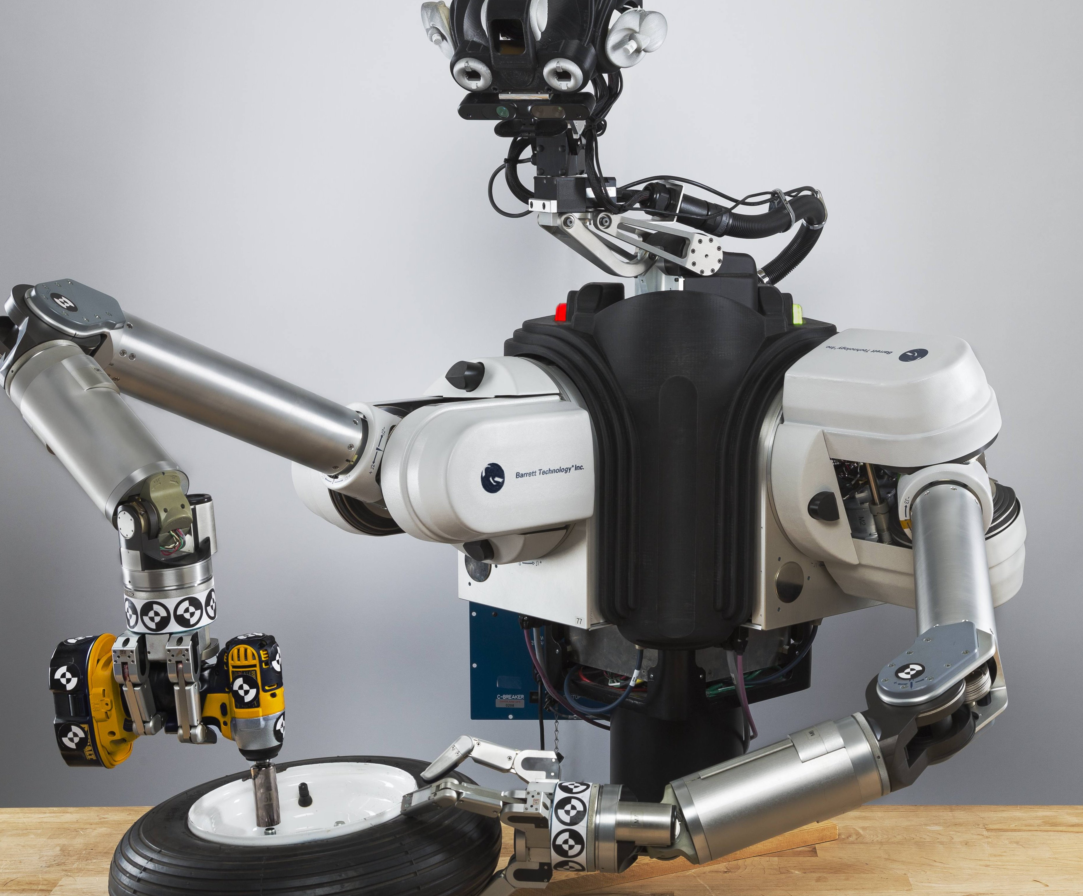
Introduction to Robotics
introduction to the hardware
Lab Assignment 1
AI407

Slide 2
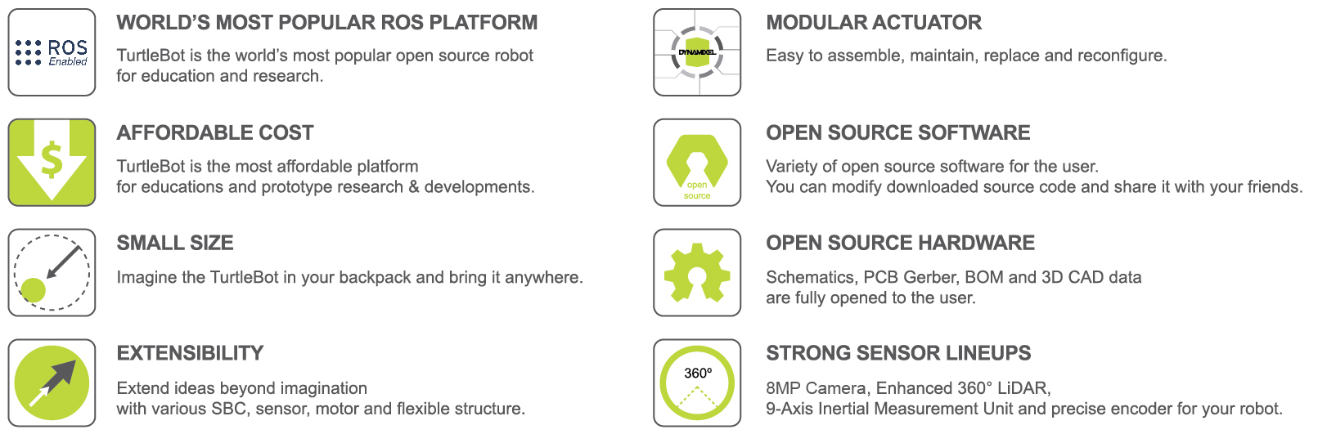
TurtleBot3
TurtleBot is a standardized mobile robotic platform for ROS education and research. It has four versions: TurtleBot1 (2010), TurtleBot2 (2012), TurtleBot3 (2017), and TurtleBot4, each improving in modularity and functionality. TurtleBot3, developed by ROBOTIS, is the most popular, offering affordability, flexibility, and expandability. It supports SLAM, navigation, and manipulation, making it ideal for education, research, and prototyping.

Slide 3
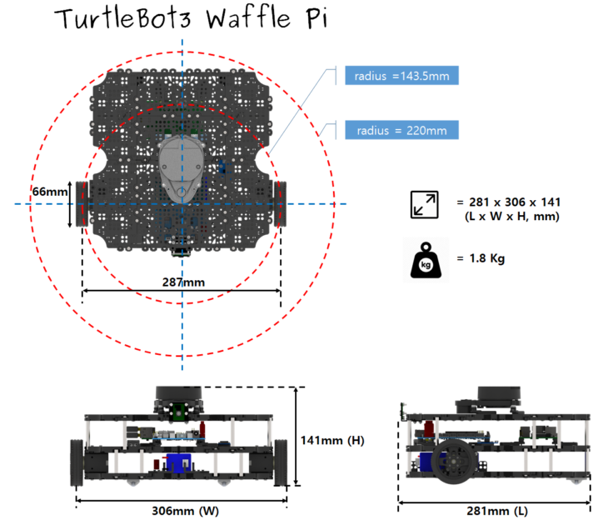
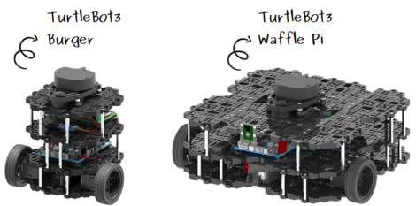

Slide 4
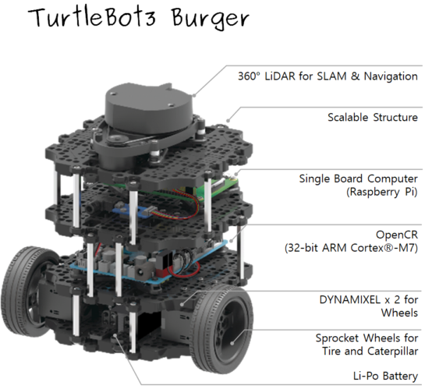
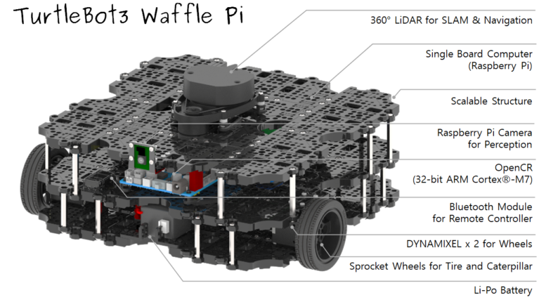

Slide 5
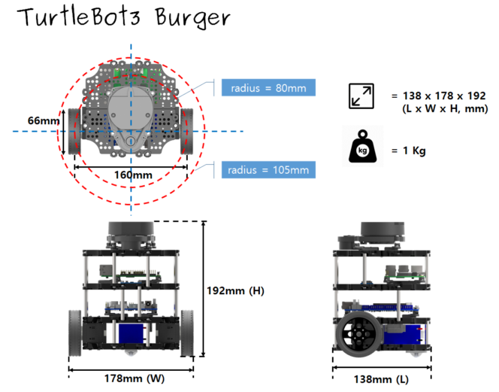
The TurtleBot3 comes in two models, Burger and Waffle Pi, with key differences in actuators, SBC, sensors, chassis, and remote controllers—Burger uses DYNAMIXEL XL430-W250-T, while Waffle Pi has DYNAMIXEL XM430-W210-T and includes a Raspberry Pi Camera v2.1 and Bluetooth/RC-100B remote controllers, making it more advanced and robust.
https://emanual.robotis.com/docs/en/platform/turtlebot3/learn/

Slide 6
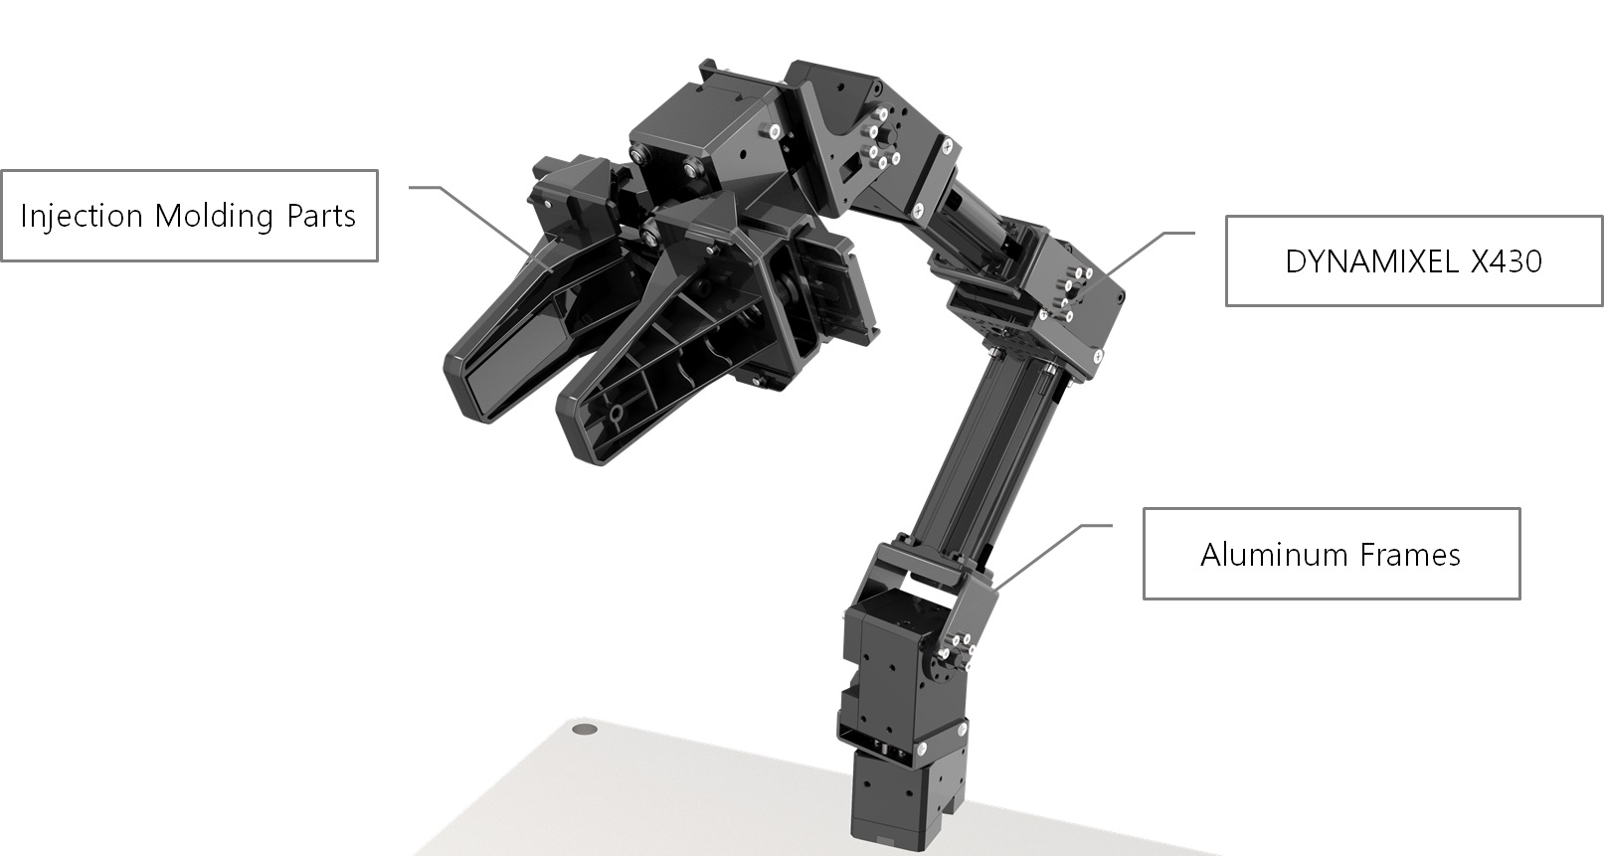
Open manipulator X

Slide 7
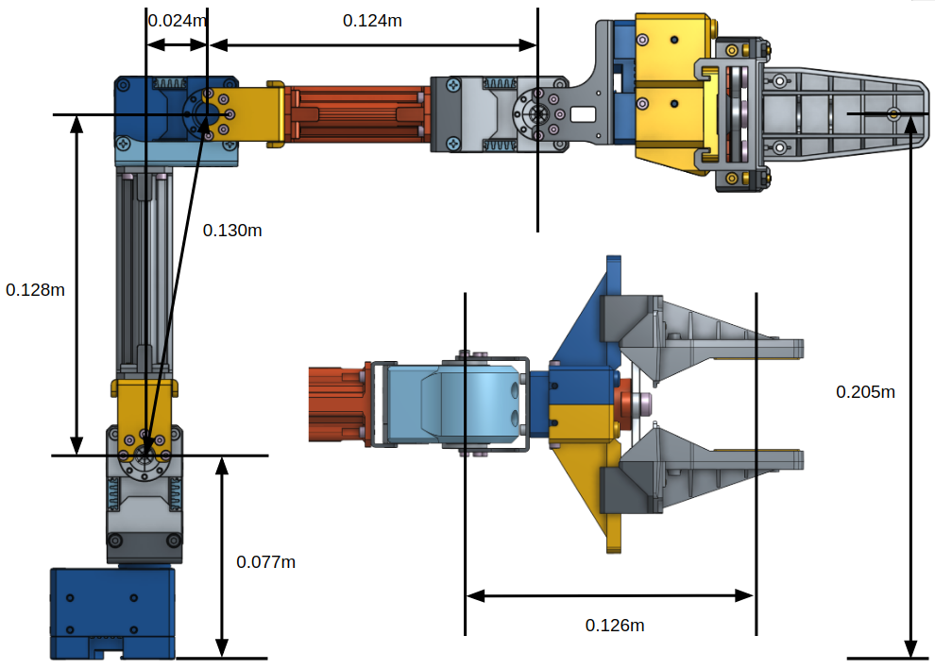

Slide 8
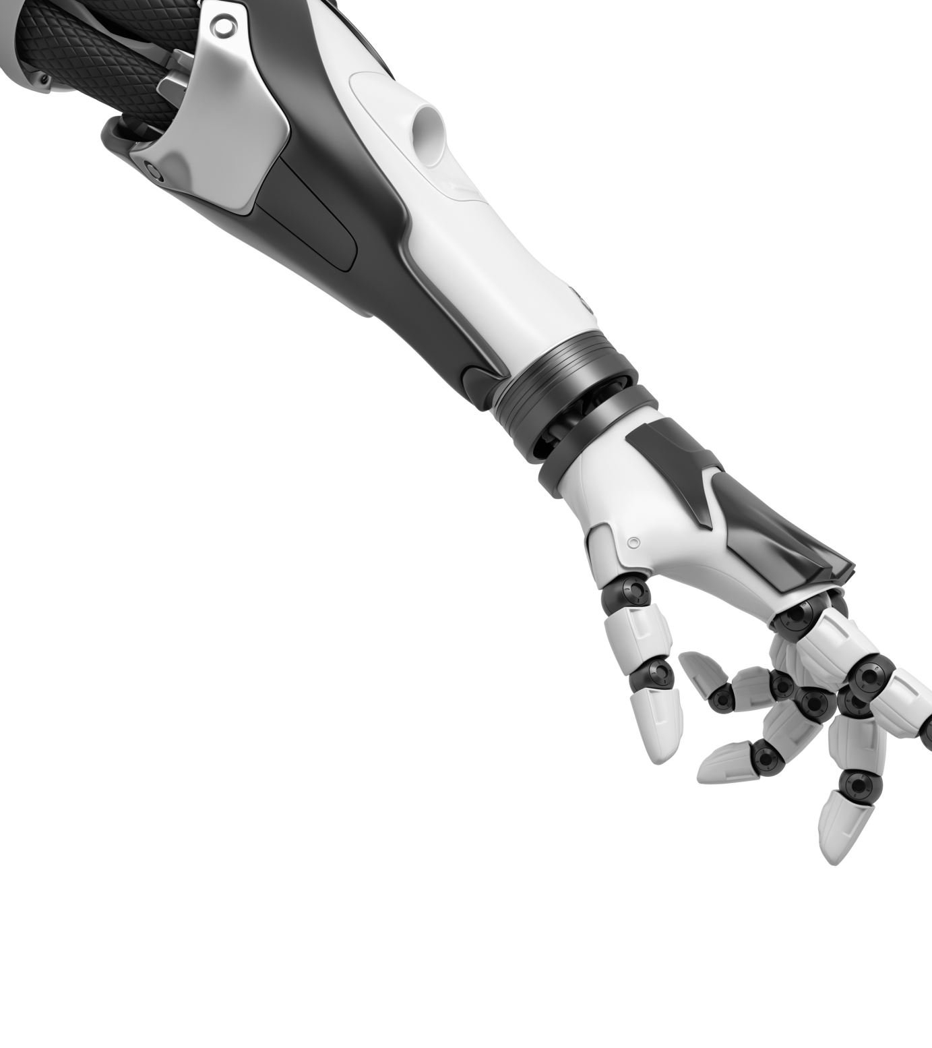
🚀 Users can develop on either an embedded system (OpenCR) or a PC with ROS and a DYNAMIXEL Starter Set.
OpenMANIPULATOR-X (RM-X52-TNM) Overview
OpenMANIPULATOR-X is a ROS-compatible robotic arm platform featuring open-source software and hardware. It is fully compatible with TurtleBot3 and can be controlled via MoveIt! in ROS or simulated in Gazebo.
Key Features
• Open Source Software: Supports ROS/ROS2 and integrates with TurtleBot Arm.
• Open Source Hardware: STL files are available for 3D printing, allowing custom modifications.
• DYNAMIXEL-X Series: Uses modular actuators, enabling users to build different robotic arm types.
• OpenCR Controller: Provides real-time control for kinematics and motion profiling.
• Expandable Design: Supports 7 configurations: Chain, SCARA, Link, Planar, Delta, Stewart, and Linear.

Slide 9
The OpenMANIPULATOR-X Quick Start Guide provides step-by-step instructions for setting up and operating the robotic arm using either ROS Noetic on Ubuntu 20.04 (with a PC as the main controller) or Arduino IDE with OpenCR (as a standalone setup), including software installation, hardware connection, communication setup via U2D2 or OpenCR, and configuring the Processing GUI for easier control.
The OpenMANIPULATOR-X is a 5-DOF robotic arm using DYNAMIXEL XM430-W350-T actuators, operating at 12V, with a 500g payload, <0.2mm repeatability, 380mm reach, and ROS-compatible control via PC or OpenCR.
https://emanual.robotis.com/docs/en/platform/openmanipulator_x/quick_start_guide/

Slide 10
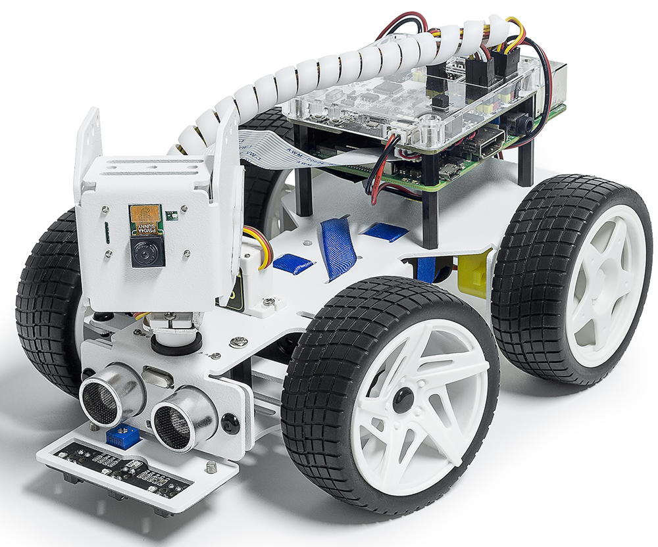
PiCar-X

Slide 11

The PiCar-X is an AI-powered self-driving robot for Raspberry Pi, featuring a 2-axis camera, ultrasonic module, and line tracking sensors for tasks like face detection, traffic sign recognition, obstacle avoidance, and line tracking, and it supports Python for advanced programming or Ezblock Studio (Blockly) for beginner-friendly, drag-and-drop coding.

Slide 12
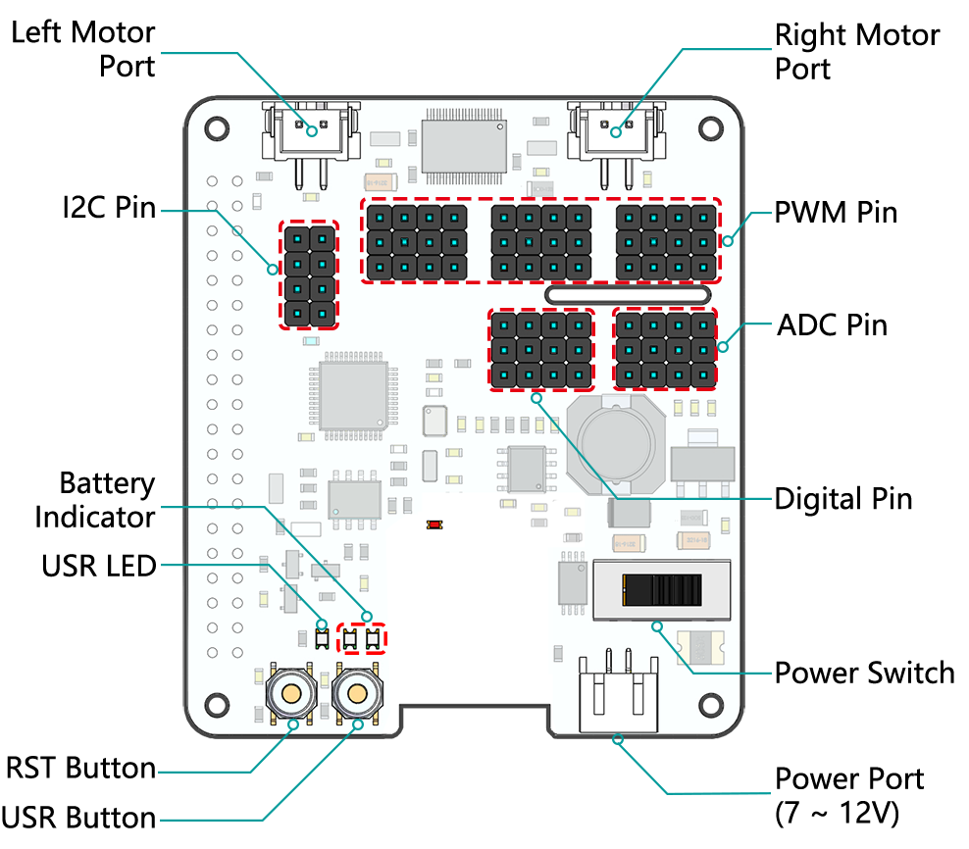
https://docs.sunfounder.com/projects/picar-x/en/latest/introduction.html

